Slide 1




Slide 2

TEST TIME ON PARAJUMBLES
URL: https://forms.gle/5Lxe1kAt8KwhdZvh7
QR CODE:

Slide 3

GEOMETRY

Slide 4
Concept
GEOMETRY
Point : A point is an exact location
Line Segment :The straight path between two points A and B is called a line segment AB. A line segment has two end points.
Ray : On extending a line segment AB indefinitely in one direction we get the ray AB.
Line : A line segment AB extended indefinitely in both directions is called line AB. Two line meet in a point , two planes meet in a line.

Slide 5
Concept
GEOMETRY
Concurrent Lines : Three or more lines intersecting at the same points are called concurrent lines.
Angle : Two rays OA and OB having a common end points O form angle AOB, written as ∠AOB
Right angle - An angle whose measure is 90° is called a right angle.
Acute angle - An angle whose measure is less than 90° is called an acute angle.

Slide 6
Concept
GEOMETRY
Obtuse angle : An angle whose measure is more than 90° but less than 180°, is called an obtues angle.
Straight angle - An angle whose measure is 180° is called a Straight angle.
Reflex angle - An angle whose measure is more than 180° but less than 360°, is called a Reflex angle.
Complete angle - An angle whose measure is 360°, is called a complete angle.
Equal angle - Two angles are said to be equal , if they have the same measure.

Slide 7
GEOMETRY
Complementary angle : Two angles are said to be complementary if the sum of their measures is 90. For example, angles measuring 65° and 25° are complementary angle.
Supplementary angle : Two angle are said to be supplementary if the sum of their measures is 180°. For example, angles measures 70° and 110° are supplementary.
Adjacent angle : Two angles are called adjacent angle if they have the same vertex and a common arm such that non-common arms are on either side of the common arm. In the given figure , ∠AOC and ∠BOC are adjacent angle.

Slide 8
Concept
GEOMETRY
Quadrilateral : A figure bounded by four straight line is called a quadrilateral. The sum of all angles of a quadrilateral is 360°. Eg : Rectangle, Square, Parallelogram, Rhombus
In a parallelogram, we have
=>Opposite sides are equal.
=>Opposite angles are equal.
=>Each diagonal bisects the parallelogram.
=>Diagonals of a parallelogram bisect each other.
Diagonals of a rectangle are equal.
Diagonals of a rhombus bisect each other at right angles.

Slide 9
Question : 01
QUESTION : 01
Question : 01
A park is in shape of a circle. A man crossed the park across its diameter
AB. What percentage of distance is saved by not walking along the
circumference?
31.4 %
11.4 %
57%
None of these
Answer: c

Slide 10
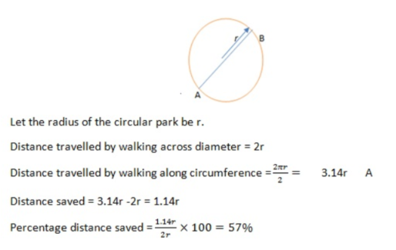
QUESTION : 01
Explanation

Slide 11
Question : 02
Question : 02
There was a rectangular in which two walls were erected parallel to its breadth to
make three square rooms. If the diagonal of the room is 4m, find the area of the
rectangular hall?
12√2 m²
24 m²
24√2m²
48 m²
Answer: b

Slide 12
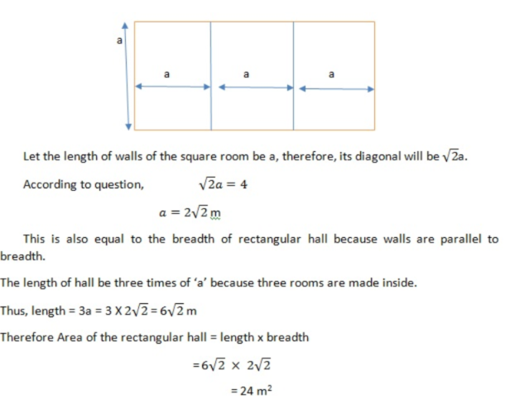
QUESTION : 02
Explanation

Slide 13
Question : 03
Question : 03
A pole of length 8.5 feet was resting against a wall with its foot at a distance of
1.3 feet from the base of the wall. Due to a hit, the top of the pole slipped by 0.7
feet. By how much would its foot slip away from the wall?
1.2 feet
0.8 feet
0.7 feet
2.3 feet
Answer: d

Slide 14
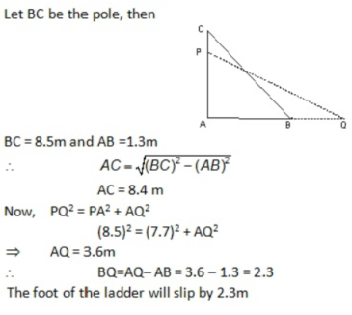
QUESTION : 03
Explanation

Slide 15
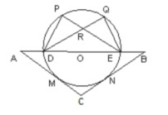
Question : 04
Question : 04
In the adjoining figure AC= BC and DE is the diameter of the circle. AC and BC
touch the circle at M and N respectively. If the angle ADP = angle BOQ =
100°. Find angle PRD = ?
20°
30°
40°
50°
Answer: a

Slide 16
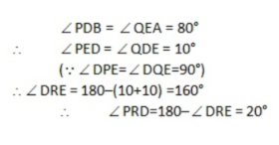
QUESTION : 04
Explanation

Slide 17
Question : 05
Question : 05
A circular pizza of radius 15 cm is to be shared by 6 people consisting of 4
children and 2 adults. Pizza is divided equally for individual child and similarly for
adults the area of the piece given to adults is 82.5 cm2. Find the angle contained
by pizza slice of child.
69°
46°
83°
38°
Answer: a

Slide 18
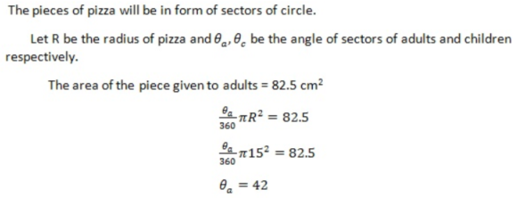
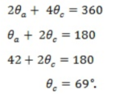
QUESTION : 05
Explanation

Slide 19
Question : 06
Question : 06
The area of a circle having radius r is equal to that of a right triangle given that
the base of the triangle is 4 times the radius. Find the ratio of altitude of triangle
to the radius of circle.
π : 2
π : 1
2 : π
None of these
Answer: a

Slide 20
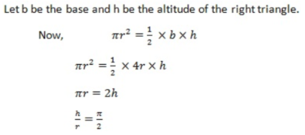
QUESTION : 06
Explanation

Slide 21
Question : 07
Question : 07
A definite length of wire is used to make a square, an equilateral triangle and a
circle such that their areas are equal. Which of the following will have a maximum
wire leftover ?
Triangle
Circle
Square
Equal for all
Answer: a

Slide 22
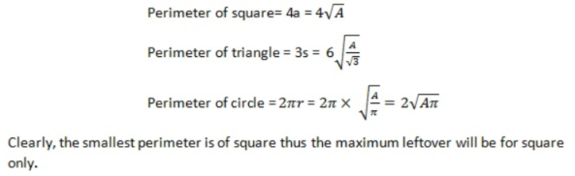
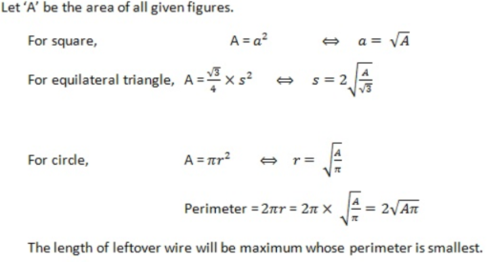
QUESTION : 07
Explanation

Slide 23
Question : 08
Question : 08
A circular frame is formed of a wire having circumference 48 cm. This frame is
bent to form regular star shape with a number of pointed vertices. If angle of
each vertex is 60ᵒ, what will be the length of one edge of the star?
6cm
8cm
4cm
2.5cm
Answer: c

Slide 24
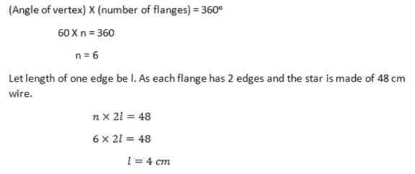
QUESTION : 08
Explanation

Slide 25
Question : 09
Question : 09
The length of the perpendiculars drawn from any point in the interior of any are
a1, a2 and a3. The length of the each side of a triangle is :
1.15(a1+a2+a3)
4(a1+a2+a3)
2.5(a1+a2+a3)
2(a1+a2+a3)
Answer: a

Slide 26
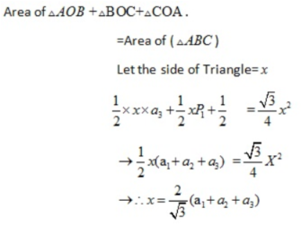
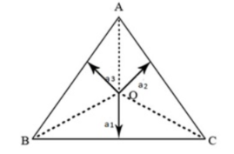
QUESTION : 09
Explanation

Slide 27
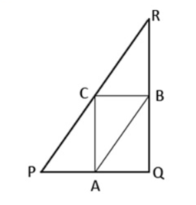
Question : 10
Question : 10
In how figure PR || AB , PQ || BC and QR || CA. Then relation between AC and QR is
AC=0.5QR
2AC= (QR)^2
AC=BQ.QR
AC.QR=1
Answer: a

Slide 28
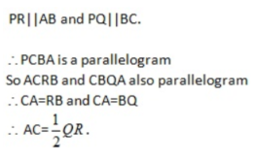
QUESTION : 10
Explanation
Notes:
Required number of ways,
=6C4
=6×52
=15 ways.

Slide 29
Question : 11
Question : 11
Two angles are supplementary and the ratio of the angels is 1:4. what is the
value of smaller angle?
36 degree
35 degree
34 degree
37 degree
Answer: a

Slide 30
QUESTION : 11
Explanation
As we know that the angles are supplementary so sum of angles will be 180 degree. Let us assume that the ratio factor is r. According to question, Angles are supplementary and have a ratio of 1:4. r + 4r = 180 ⇒ 5r = 180 ⇒ r = 180/5 ⇒ r = 36

Slide 31
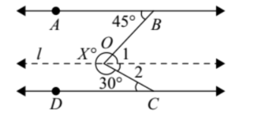
Question : 12
Question : 12
In the given, AB || CD. Then X is equal to:
93°
113°
103°
None of these
Answer: d

Slide 32
QUESTION : 12
Explanation
Through O, draw a line l parallel to both AB and CD. Then ∠1 = 45° (alt. ∠S) and ∠2 = 30° (alt. ∠S) ∴ ∠BOC = ∠1 + ∠2 = 45° + 30° = 75° So, X = 360° – ∠BOC = 360° – 75° = 285° Hence X = 285°.

Slide 33
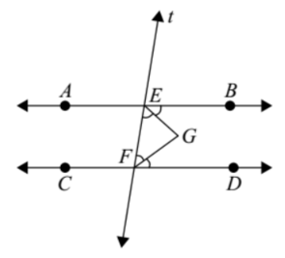
Question : 13
Question : 13
In the adjoining figure, AB || CD, t is the traversal, EG and FG are the
bisectors of ∠BEE and ∠DFE respectively, then ∠EGF is equal to :
90°
180°
160°
120°
Answer: a

Slide 34
QUESTION : 13
Explanation
AB || CD and t transversal intersects them at E and F ∠BEF + ∠EFD = 180° (co-interior angles)
∠FEG + ∠EFG = 90° In Δ GEF ∠EGF + ∠FEG + ∠EFG = 180° ∴ ∠EGF + 90° = 180° ∴ ∠EGF = 90°. The above result can be restated as : If two parallel lines are cut by a traversal, then the bisectors of the interior angles on the same side of the traversal intersect each other at right angles.

Slide 35
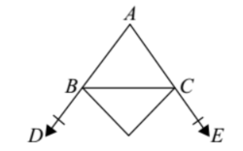
Question : 14
Question : 14
The sides AB and AC of ΔABC have been produced to D and E respectively.
The bisectors of ∠CBD and ∠BCE meet at O. If ∠A = 40°, then ∠BOC is equal to:
50°
70°
80°
90°
Answer: b

Slide 36
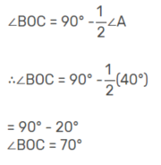
QUESTION : 14
Explanation

Slide 37
Question : 15
Question : 15
If the bisector of an angle of Δ bisects the opposite side, then the Δ is :
Isosceles
Right triangle
Circle
None of these
Answer: a

Slide 38
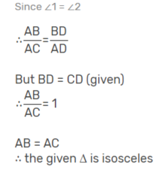
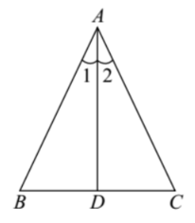
QUESTION : 15
Explanation

Slide 39

https://learn.codemithra.com

Slide 40




THANK YOU
+91 78150 95095
codemithra@ethnus.com
www.codemithra.com

